Slide 1
Heart Disease Prediction using Hybrid Machine Learning Model
Submitted By
Chirudeep Gorle
016682627

Slide 2
Abstract
Heart disease is a leading cause of death worldwide and is becoming a major health concern for many people.
Early detection of heart illness has the potential to save many lives; nevertheless, routine clinical data analysis has significant difficulties in identifying cardiovascular disorders such as heart attacks, coronary artery diseases, etc.
The suggested work suggests a revolutionary machine-learning technique to forecast cardiac disease.
Three machine learning algorithms—Random Forest, Decision Tree, and Hybrid Model (a hybrid of Random Forest and Decision Tree)—are employed in the implementation.
According to experimental findings, the hybrid model's heart disease prediction accuracy rate is 88.7%.
We employed a hybrid model of a Decision Tree and Random Forest in the interface to collect the user's input parameter to forecast heart disease.

Slide 3
INTRODUCTION
A lot of data may be studied and understood with the help of data mining. It is used to extract data and to decide whether to move on with other applications.
Data mining methods including clustering, association rule mining, and classifications are the most often used methods. These data mining approaches may be implemented using a wide variety of algorithms.
Although there are simulation programs like Weka accessible, Python programming is growing in popularity because of these algorithms created with the Scikit Learn packages. The use of data mining ideas in real-time is therefore more trustworthy than before.

Slide 4
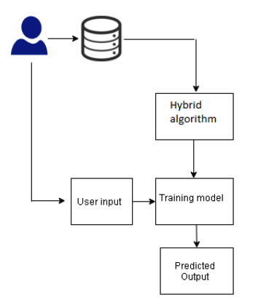
Block diagram of Heart Disease prediction
The main motto is to predict heart disease based on machine learning using an automated medical diagnosis method.
So, we are taking the hybrid model which is the finest classification method for predicting.
I have chosen the Cleveland dataset from Kaggle for processing the algorithm.
The dataset contains 303 instances and around 14 characteristics.
I classify it in the form binary classification type ‘0’ means absence of heart disease and ‘1’ means presence of heart disease

Slide 5
RELATED WORK
Researchers are now studying a wide variety of contemporary studies on heart disease analysis and prediction. These works are discussed below.
Using the Cleveland dataset and random forest, the author investigates cardiac disease. For the investigation, the author employed the Chi-Square feature selection model and a feature selection model based on a genetic algorithm (GA).
The available studies suggest that innovation in the study is required and that a reliable, optimized model is required for heart disease prediction.
The available machine learning techniques, either implemented using tools like Weka or MATLAB, are used to describe the present research. Deep learning is used in several of the works as well. The improved model, however, is not investigated.
Our suggested model completes the originality of labor. To produce better optimal outcomes, a hybrid model is used in its implementation.

Slide 6
PROPOSED WORK
A hybrid model is a cutting-edge method that leverages probabilities obtained from one machine-learning model as input to the other model.
This hybrid model, which is taken into consideration for implementation, provides us with better-optimized results.
The sklearn libraries, pandas, matplotlib, and other required libraries are used to implement the suggested work. We've obtained the dataset from the UCI repository.
The downloaded information divides the cardiac disease into binary categories. The hybrid model, such as a decision tree and random forest, is implemented along with the machine learning method.

Slide 7
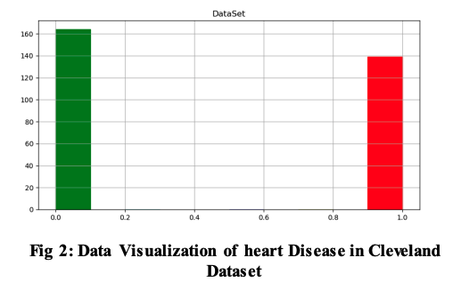
DATASET DETAILS
a collection of data with qualities
sex denotes the patient's gender
age denotes the patient's age
trestbps denotes the resting blood pressure
cp denotes chest pain,
fbs denotes fast blood sugar
chol denotes cholesterol
thalach denotes the highest heart rate reached
restecg denotes the resting electrocardiogram result (1 anomaly)
oldpeak denotes ST depression-induced ex
exang denotes exercise-induced angina
Thalassemia is indicated by the prefix ST and the suffix thal

Slide 8
The proposed workflow has the following advantages
Used a hybrid model and two machine learning algorithms
All presented algorithms are accurate, demonstrating the optimal model.
To make the suggested model function as an optimal model, implement a hybrid model.
The execution is carried out with the below-given methodologies
Dataset is collected from uci.edu
Data Visualization is done
Splitting dataset into test and train data
Apply DT and RF models for training and analysis
Train the model
Test the trained model and predict values
Get single input from the user and predict heart disease through a hybrid model

Slide 9
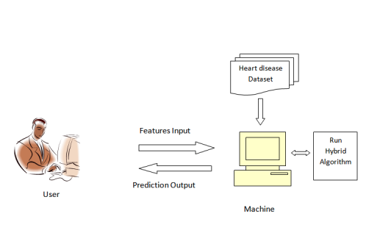
Heart disease prediction system architecture
Firstly, the user sends a feature input and the heart disease dataset which may contain a number of instances and characteristics.
Following with the algorithm we have taken for classification
So after giving the complete inputs to the machine by using machine learning algorithms like decision tree, random forest regression
The machine performs wrangling the dataset from the hybrid algorithm
Finally, it gives a predictable output to the user.

Slide 10
machine learning algorithm models
Decision Tree: One of the learning models used to solve the categorization problem is the decision tree. Using this method, we split the dataset into two or more sets. Internal nodes of a decision tree indicate a test of the features, a branch represents the result, and leaves reflect the decisions that are produced after further processing.
Random Forest Regression: Random Forest regression aggregates multiple decisions to make a single decision. For training characteristics and then random sub-characteristics for sampling nodes, random sampling is done.
Split the dataset into the test set and the train. Subsets should be made in such a way that each subset contains a feature attribute like that.

Slide 11
machine learning algorithm models
Hybrid Model: Using the decision tree and random forest algorithms, we create a hybrid model. Based on random forest probabilities, the combined model operates. The decision tree algorithm receives the train data together with the probabilities from the random forest. In a similar manner, test data are found and loaded with decision tree probabilities. Values are forecasted at the end.
Implementing machine learning on a preprocessed dataset is done; the anticipated cardiovascular disease for the given test dataset is plotted.
The user/ patient can give their own input and detect the threat of heart disease.
Disease prediction is classified as a binary prediction type, which means 0 - normal and 1- Heart disease. The application is designed using TkInter in python.

Slide 12
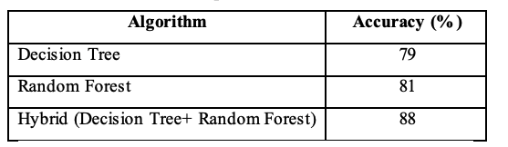
RESULTS AND DISCUSSIONS
Sklearn libraries, pandas, matplotlib, and other necessary libraries were used to implement the suggested task.
The study will take into account the heart disease dataset that was downloaded from uci.edu.
Decision Tree and Random Forest were two examples of machine learning methods employed.
We created a Decision Tree and Random Forest hybrid model to enhance the work and originality of the job.
The outcome demonstrates that a hybrid model and the Random Forest algorithm are excellent in detecting heart disease.
Random forest and Hybrid models both attain 88% accuracy, whereas Decision Tree gets roughly 79% accuracy.

Slide 13
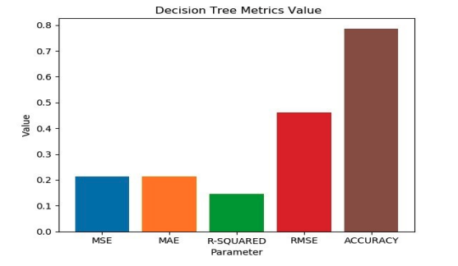
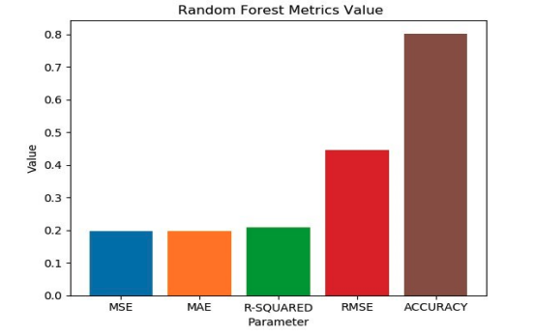
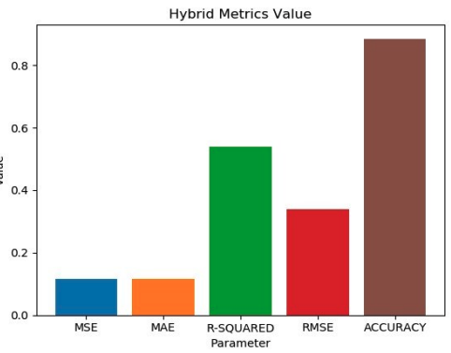
Heart Disease prediction through Various Models
Figure shows the mean square error (MSE), mean absolute error (MAE), R-Squared parameter, root mean square error (RMSE) and accuracy for Decision Tree model.
Figure shows the mean square error (MSE), mean absolute error (MAE), R-Squared parameter, root mean square error (RMSE) and accuracy for Random Forest model.
Figure shows the mean square error (MSE), mean absolute error (MAE), R-Squared parameter, root mean square error (RMSE) and accuracy for Hybrid model.

Slide 14
CONCLUSION
One of the potentially fatal diseases that is prevalent around the world is heart disease. The threat to condition increases as a result of changing lifestyles and a lack of physical activity.
The medical sector offers a variety of diagnostic procedures. However, machine learning is seen to be the best option in terms of accuracy.
The application created by TkInter Python is used in the proposed study to forecast cardiac disease.
The suggested approach employs a hybrid model that combines a Decision Tree and Random Forest for the prediction of heart disease.
For this investigation, the Cleveland database is utilized.

Slide 15
FUTURE WORK
Deep learning algorithms are essential in applications for the healthcare industry. Therefore, using deep learning techniques to forecast heart disease may produce superior results. In order to determine the severity of the sickness, we are also interested in categorizing it as a multi-class problem.

Slide 16
REFERENCES
Jabbar, M. A., B. L. Deekshatulu, and Priti Chandra. "Intelligent heart disease prediction system using random forest and evolutionary approach." Journal of Network and Innovative Computing 4.2016 (2016): 175-184.
Alkeshuosh, Azhar Hussein, et al. "Using PSO algorithm for producing best rules in diagnosis of heart disease." 2017 international conference on computer and applications (ICCA). IEEE, 2017.

Slide 17
Thank you

